Slide 1


Slide 2




Augmenting Microsoft 365 development using Visual Studio Codespaces
Don Kirkham
Solutions Architect
Microsoft Certifications
Professional Developer
Azure
Power Platform
Microsoft 365
Contact Info
https://DonKirkham.com
donkirkham@live.com
@DonKirkham
@DonKirkham

Slide 3
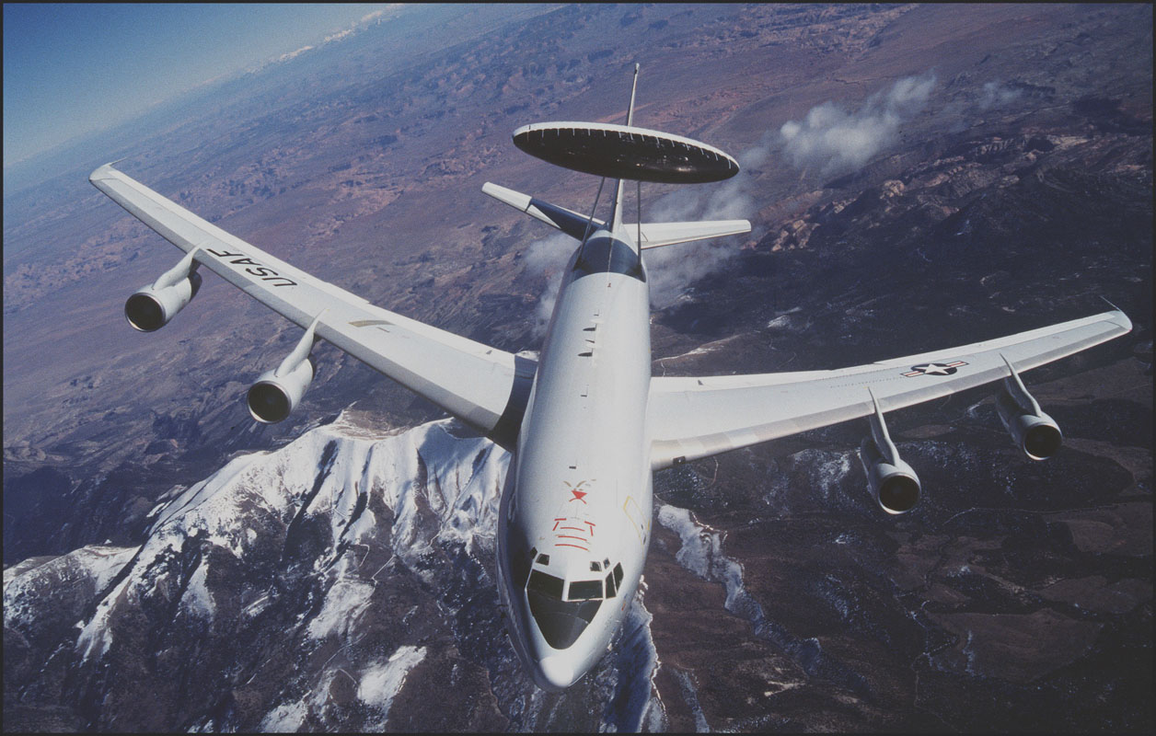
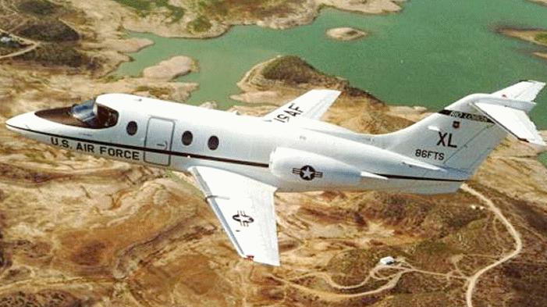
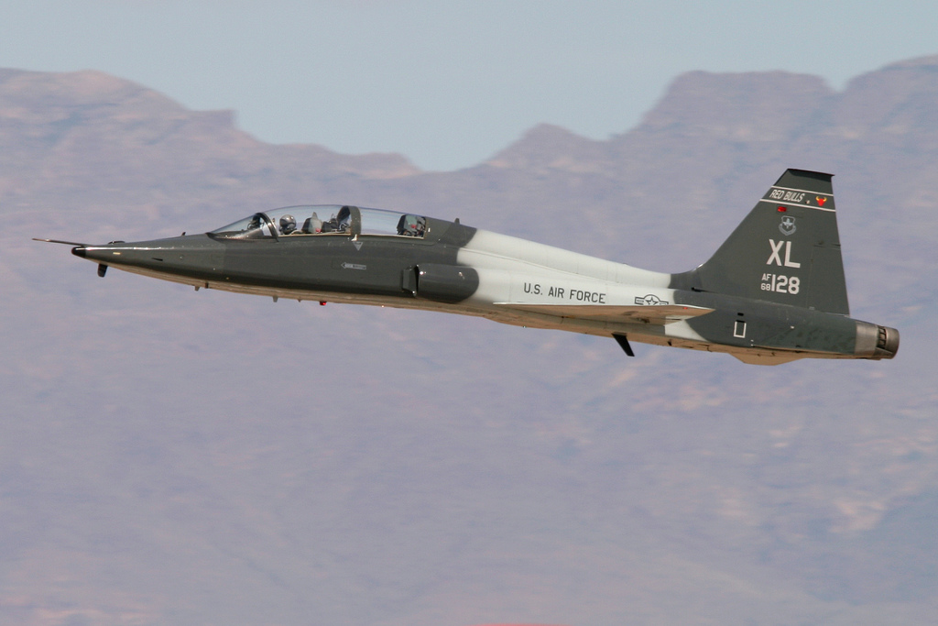
What’s with the airplanes?

Slide 4
What Is A Dev Environment?

Slide 5

What Is A Dev Environment?
Editor

Slide 6

What Is A Dev Environment?
Editor
Source

Slide 7

What Is A Dev Environment?
Editor
Source
Runtimes

Slide 8

What Is A Dev Environment?
Editor
Debugger
Source
Runtimes

Slide 9

What Is A Dev Environment?
Editor
Debugger
Source
Runtimes
Packages

Slide 10

What Is A Dev Environment?
Editor
Debugger
Tools
Source
Runtimes
Packages

Slide 11

What Is A Dev Environment?
Terminal
Editor
Debugger
Tools
Source
Runtimes
Packages

Slide 12

What Is A Dev Environment?
Terminal
Editor
Debugger
Tools
Source
Extensions
Runtimes
Packages

Slide 13

What Is A Dev Environment?
Terminal
Editor
Debugger
Config
Tools
Source
Extensions
Runtimes
Packages

Slide 14

What Is A Dev Environment?
Terminal
Project
Editor
Debugger
Config
Tools
Source
Extensions
Runtimes
Packages

Slide 15

What Is A Dev Environment?
You!
Terminal
Project
Editor
Debugger
Config
Tools
Source
Extensions
Runtimes
Packages

Slide 16


What Is A Dev Environment?
You!
Terminal
Project
Editor
Debugger
Config
Tools
Source
Extensions
Runtimes
Packages

Slide 17

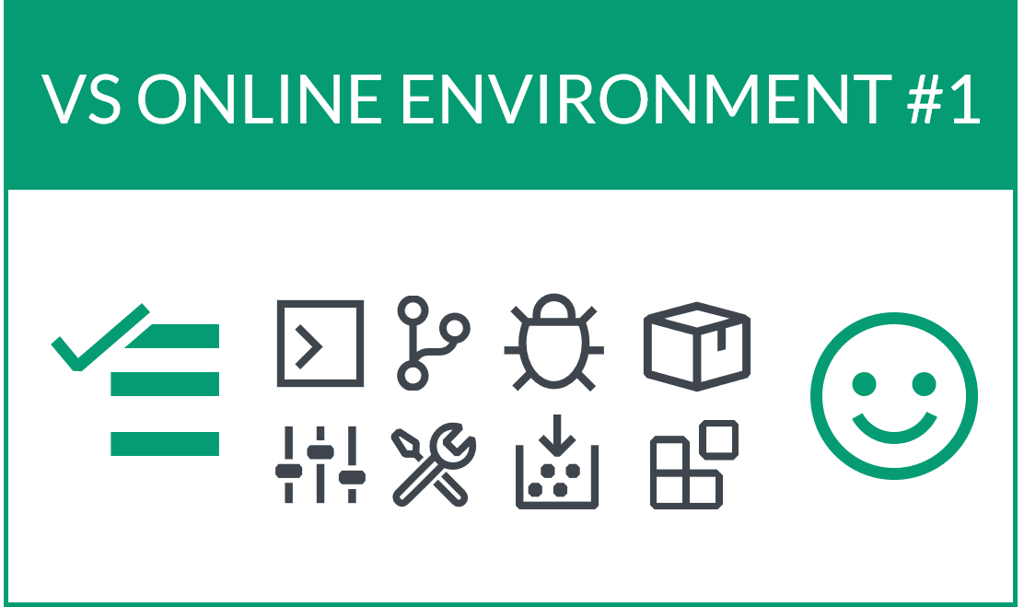


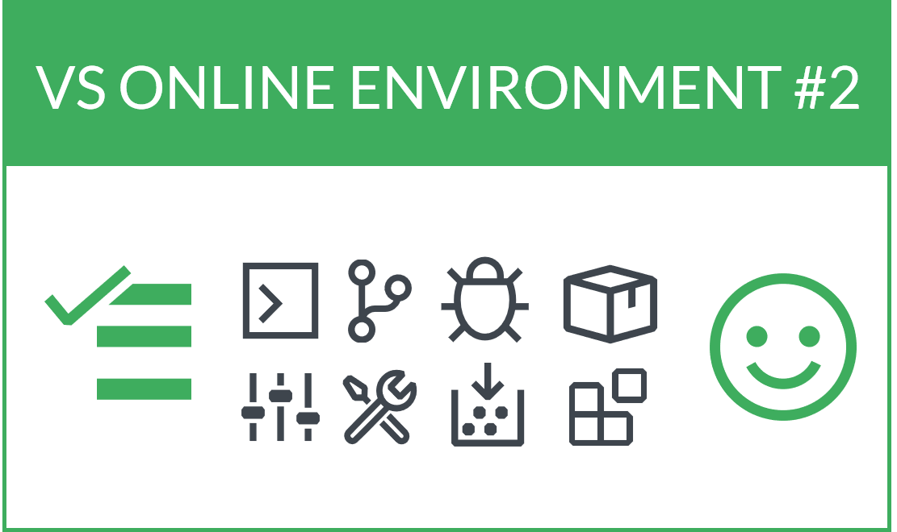








Visual Studio CODESPACES
Azure-Hosted
Editors
Compute
Network
Storage

Slide 18
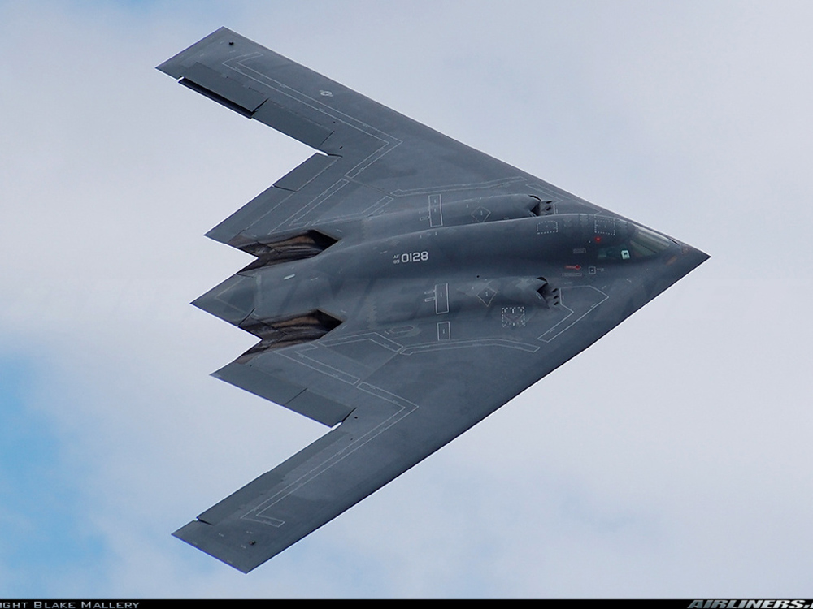
DEMO TIME!!
Oh great demo gods… please be kind… We offer Simon as sacrifice…
LET’S GO!

Slide 19
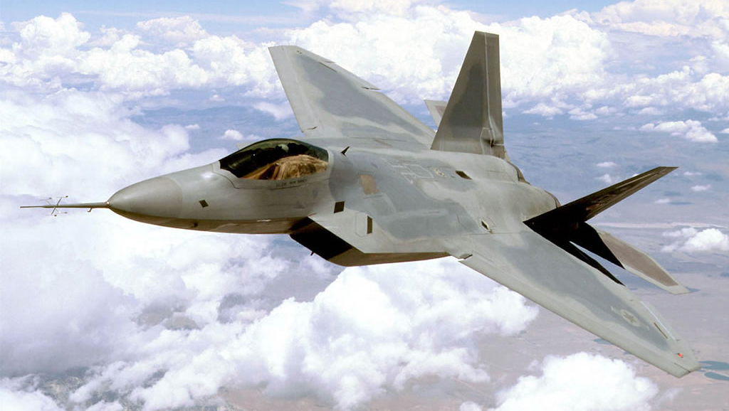
Codespaces Advantages
On-demand
Environment agnostic
Disposable
Performance
Costs

Slide 20
Questions?
Don Kirkham
Solutions Architect
Contact Info
Blog: DonKirkham.com
Email: donkirkham@live.com
Twitter: DonKirkham
Github: DonKirkham

Slide 24


Slide 25


Slide 26
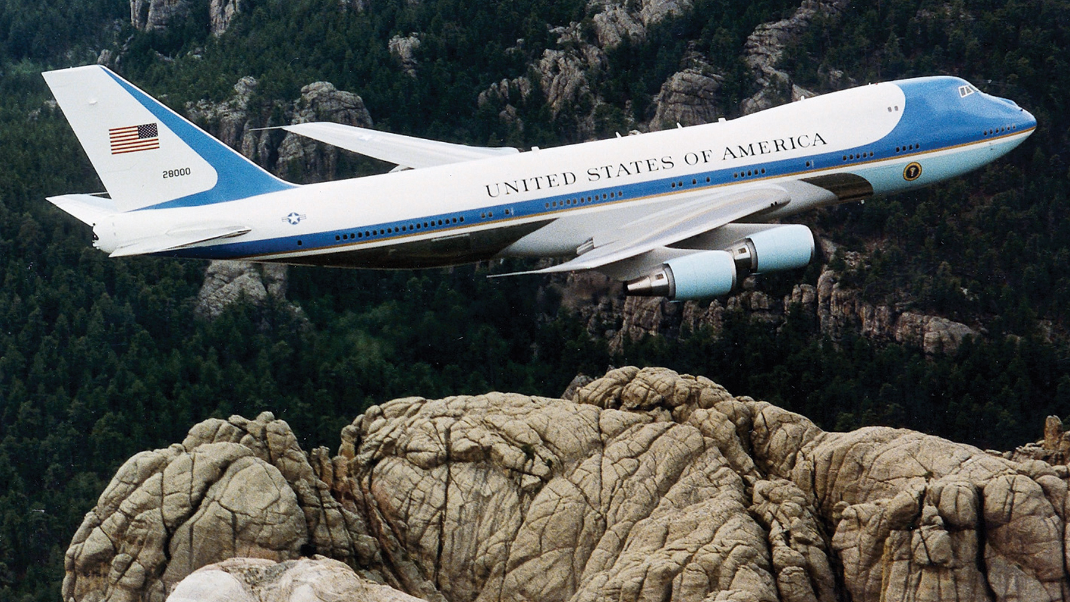

Slide 27
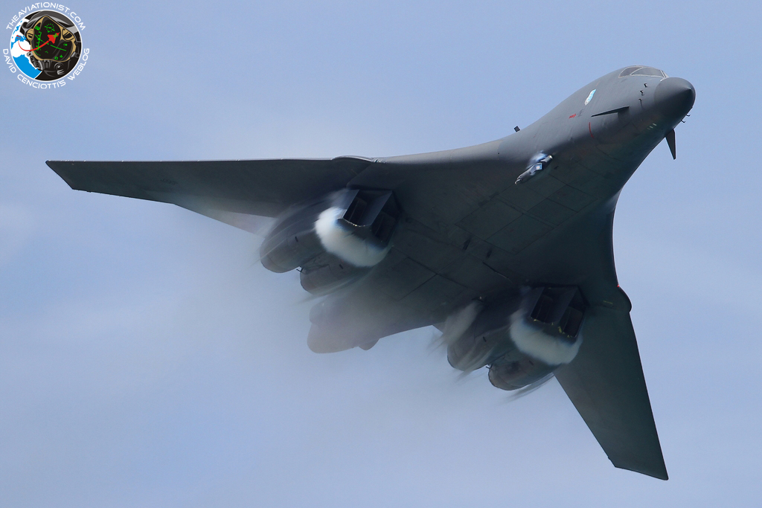


Slide 28
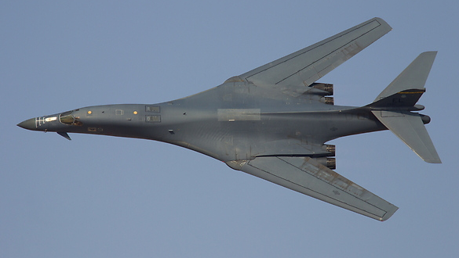

Slide 30
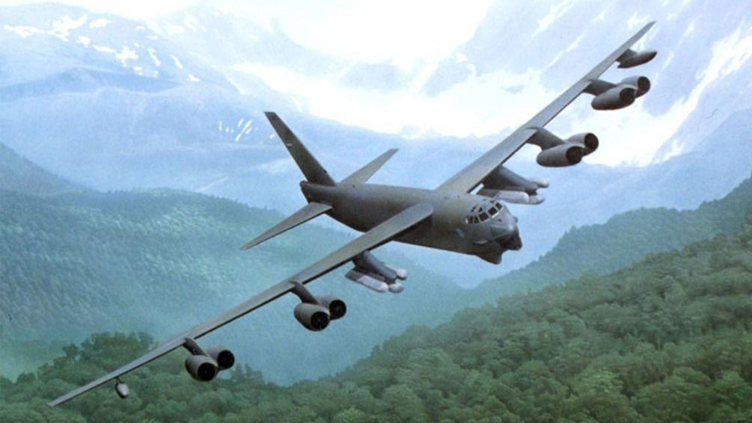

Slide 31
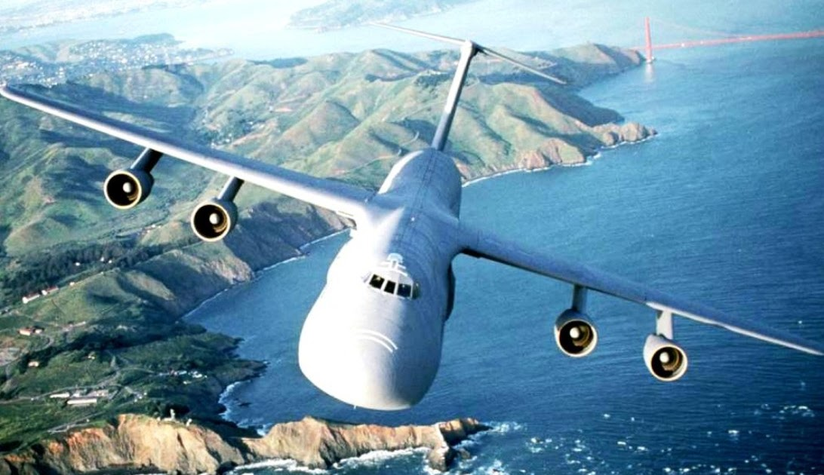

Slide 32
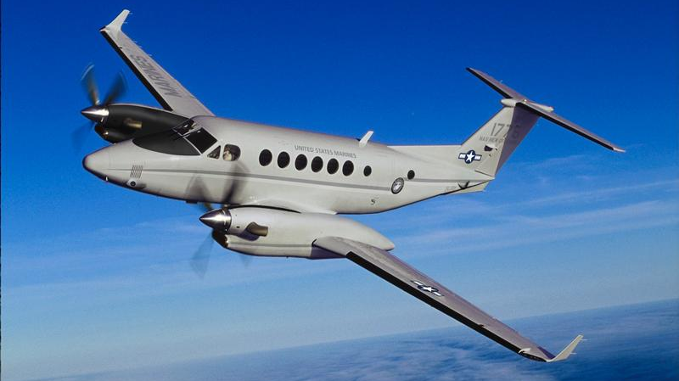

Slide 33
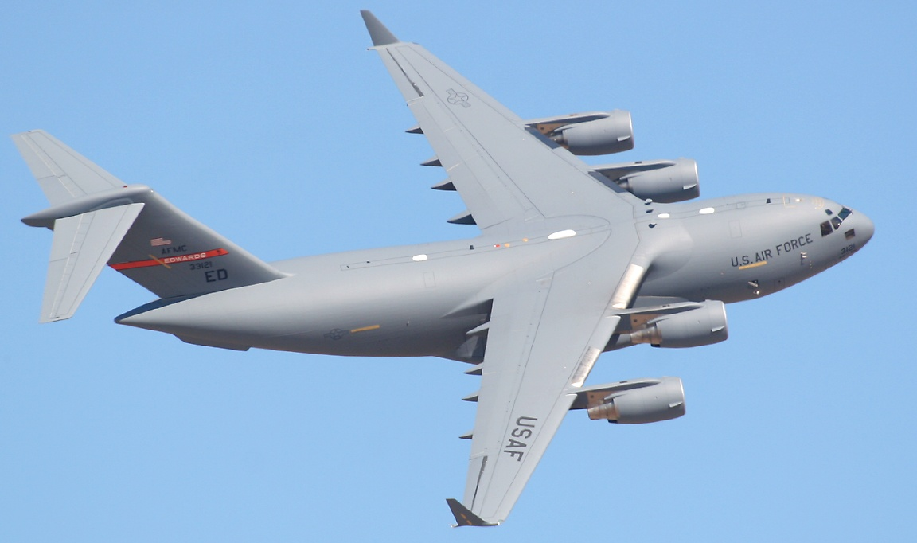

Slide 34
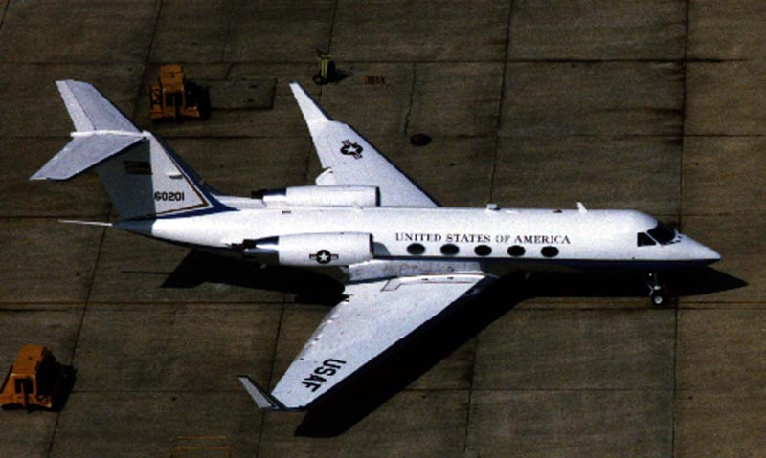

Slide 35
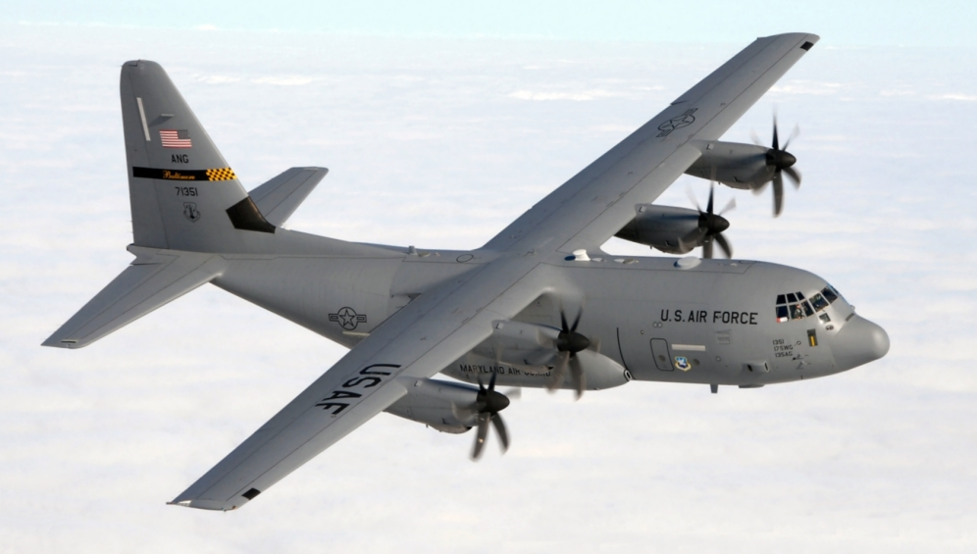

Slide 37
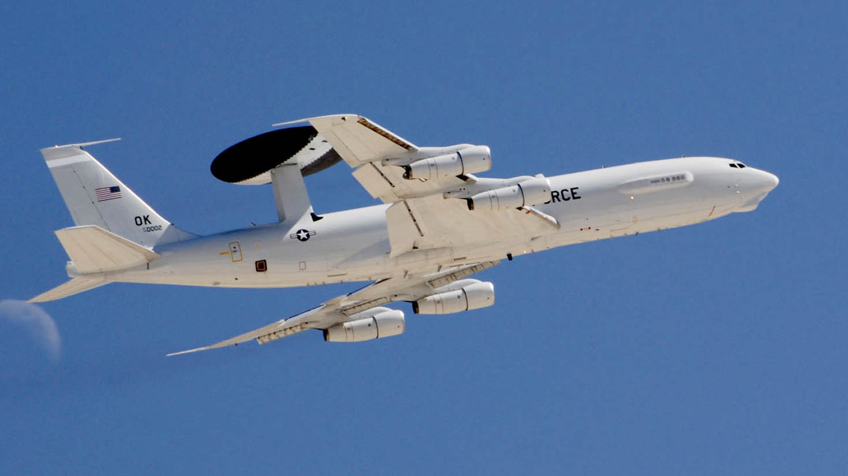

Slide 38
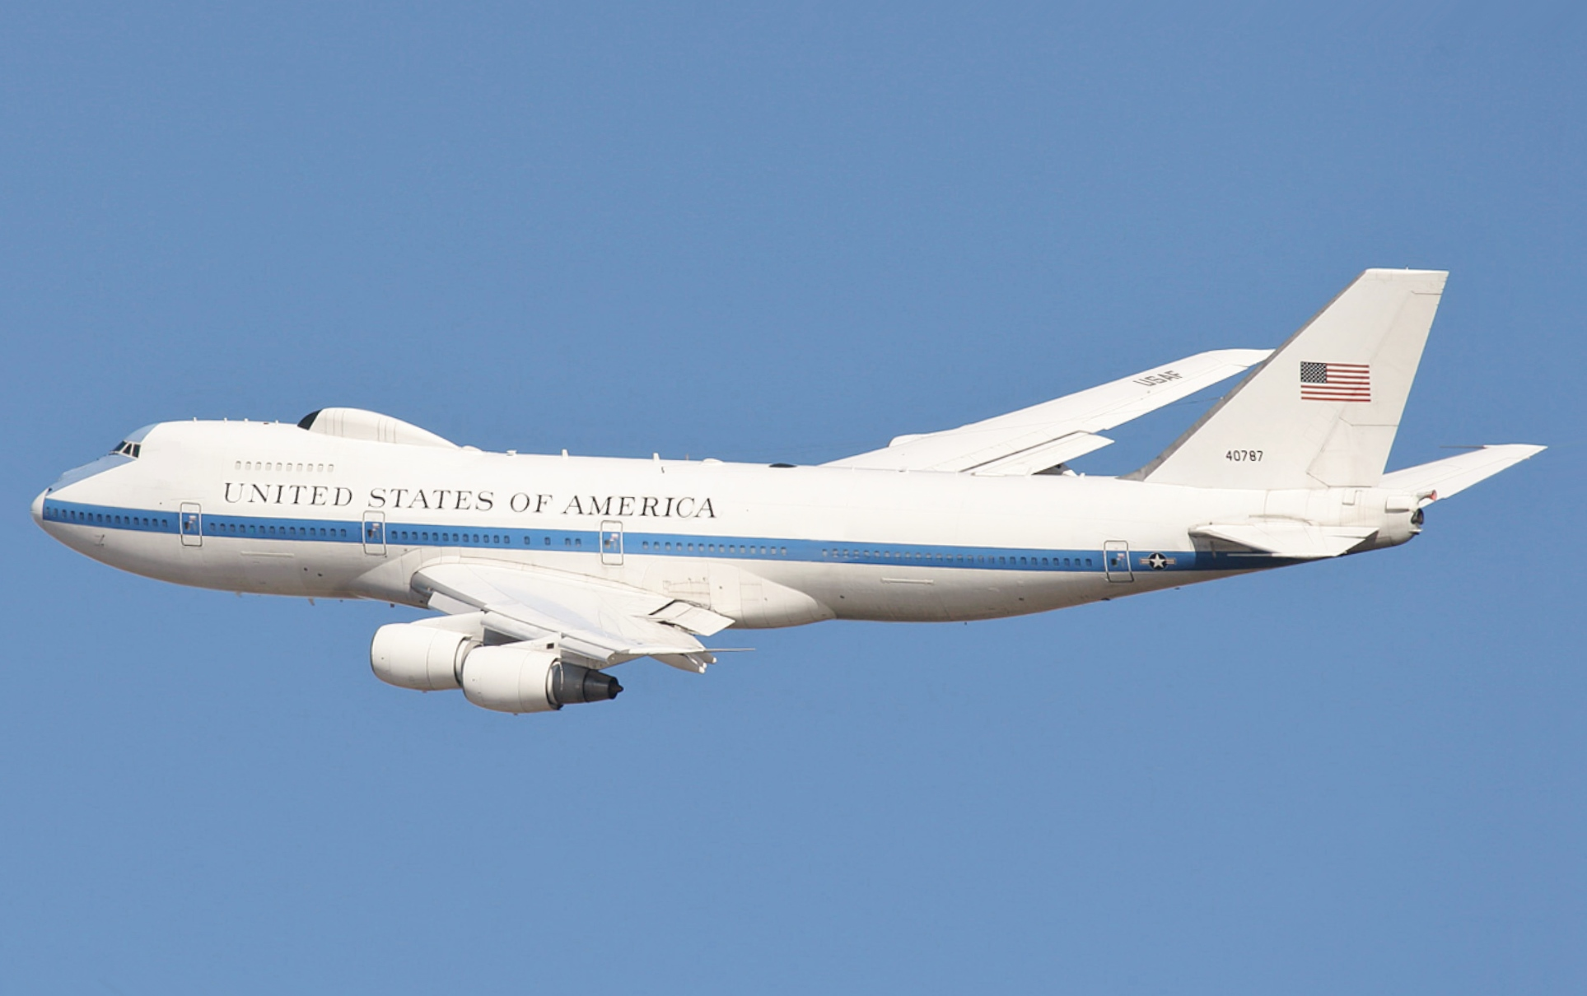

Slide 39
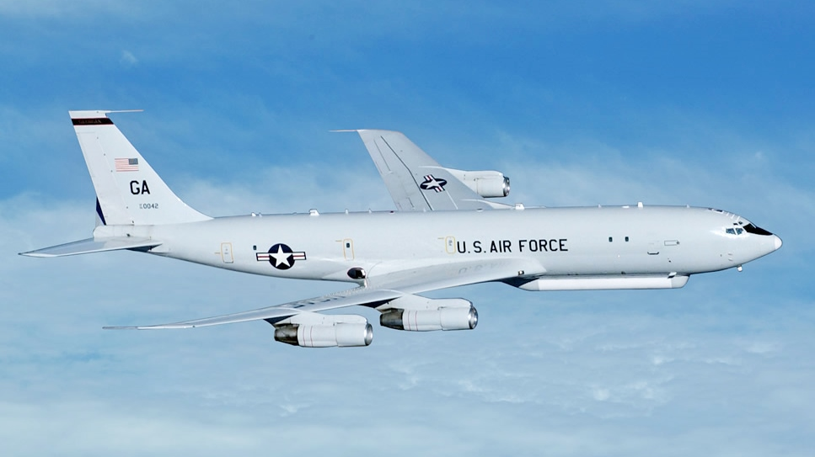

Slide 40


Slide 42
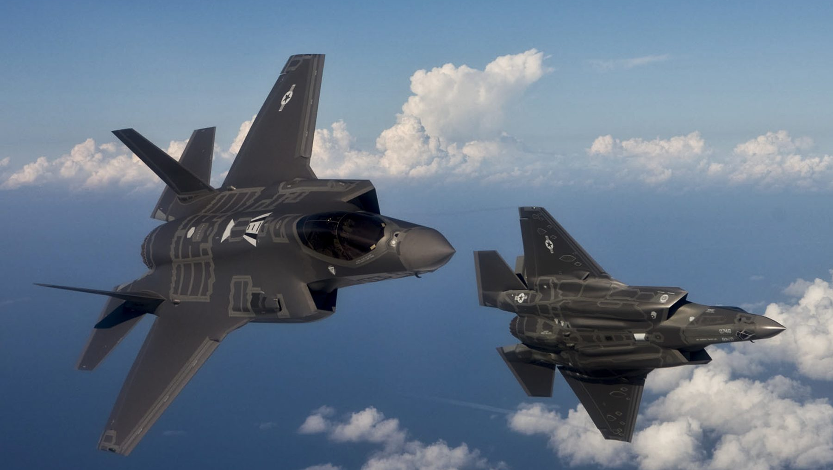

Slide 43
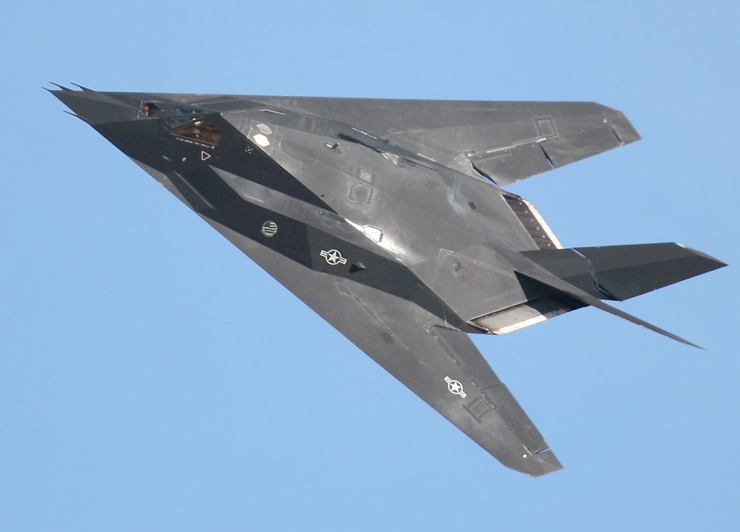

Slide 44
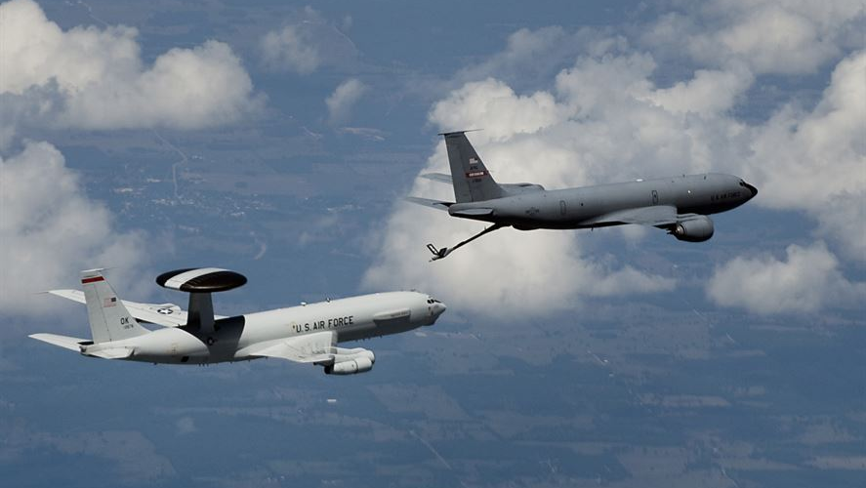

Slide 45
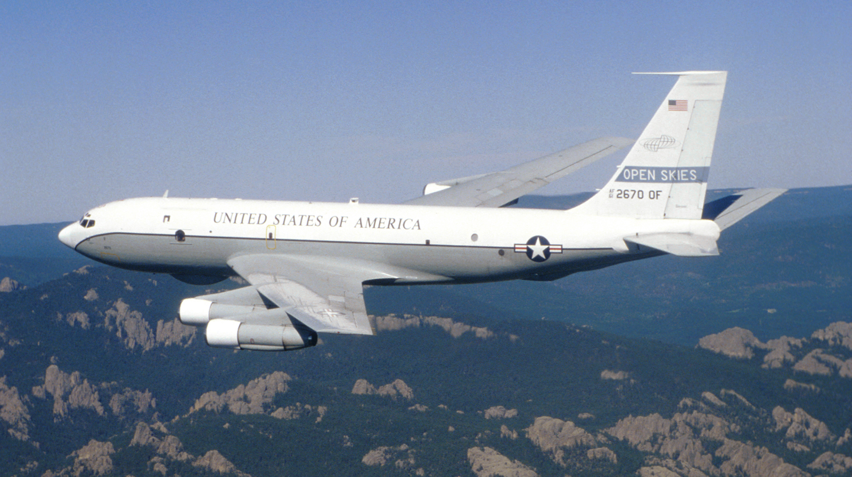

Slide 46
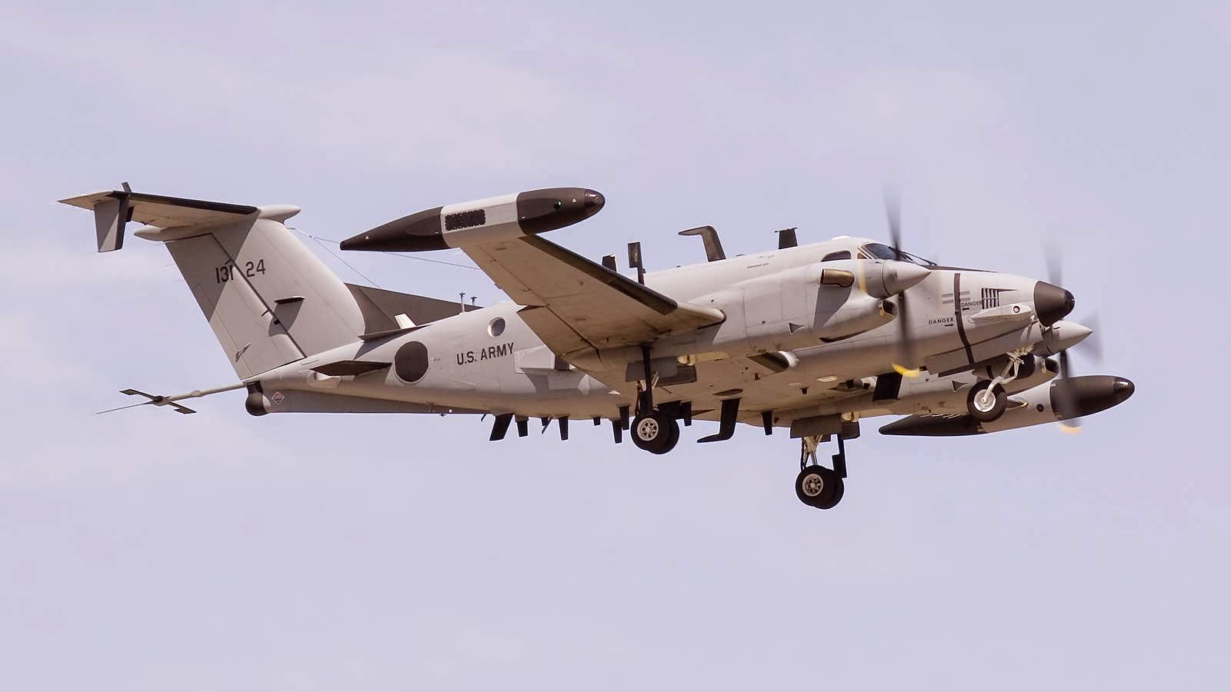

Slide 47
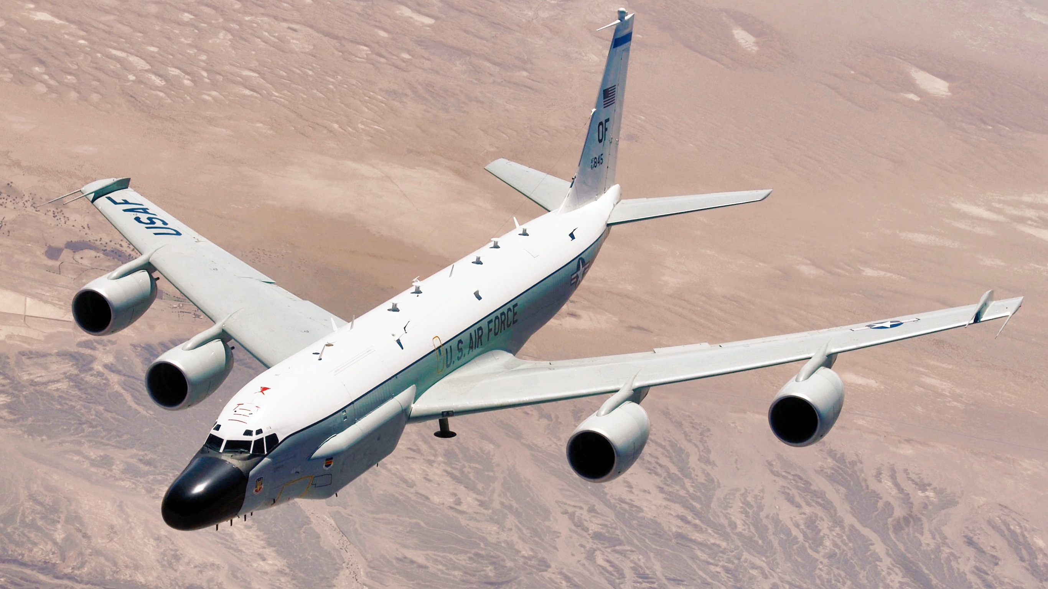

Slide 48
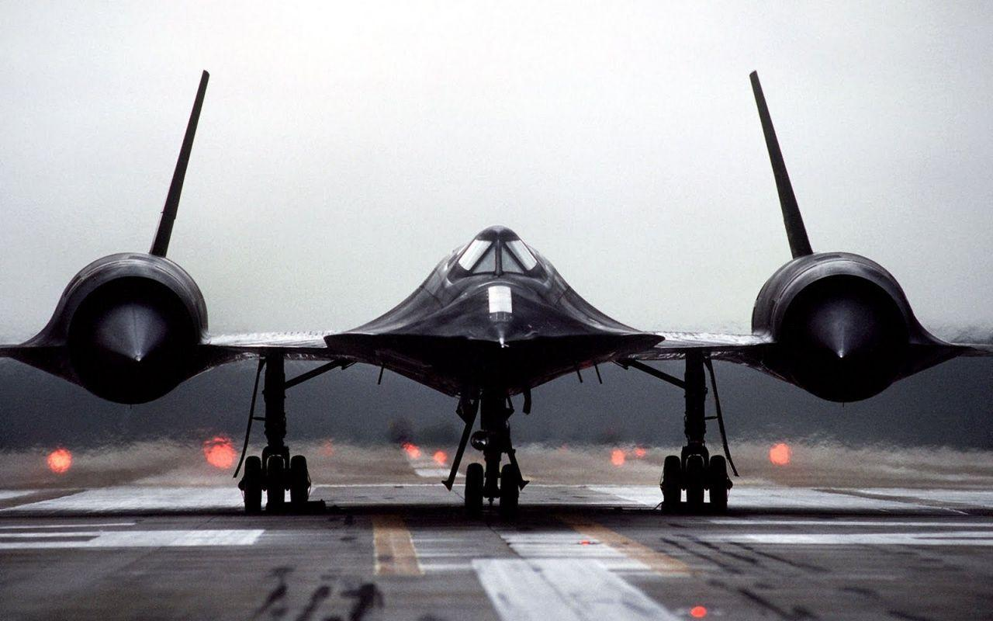

Slide 49
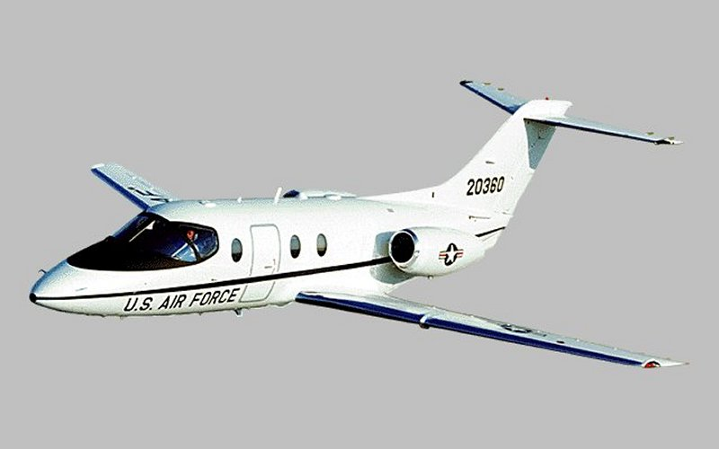

Slide 51


Slide 52
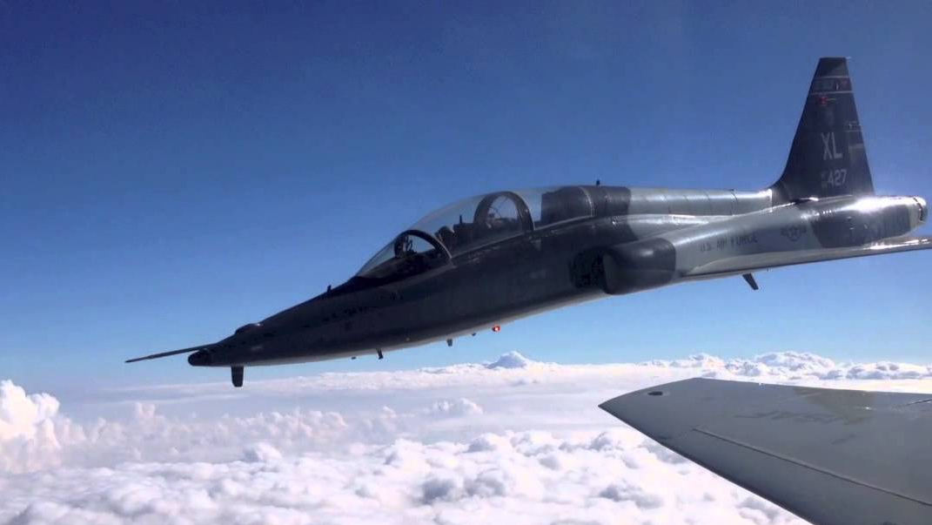

Slide 54


Slide 55
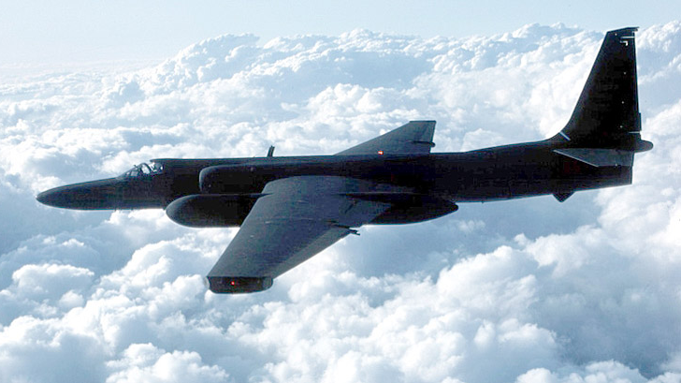

Slide 56
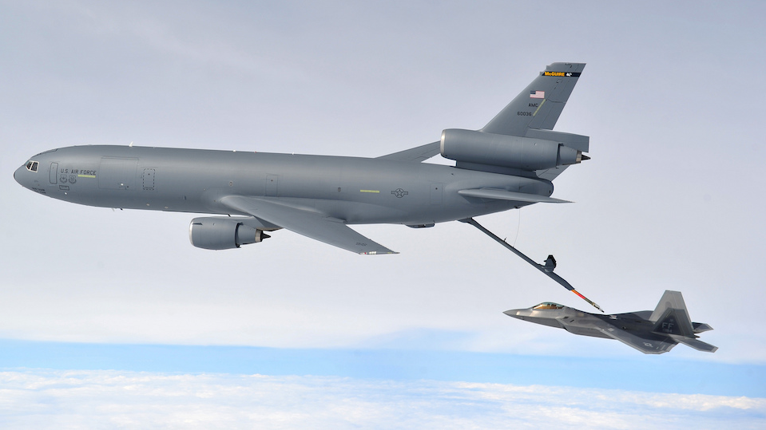

Slide 57
